Slide 1
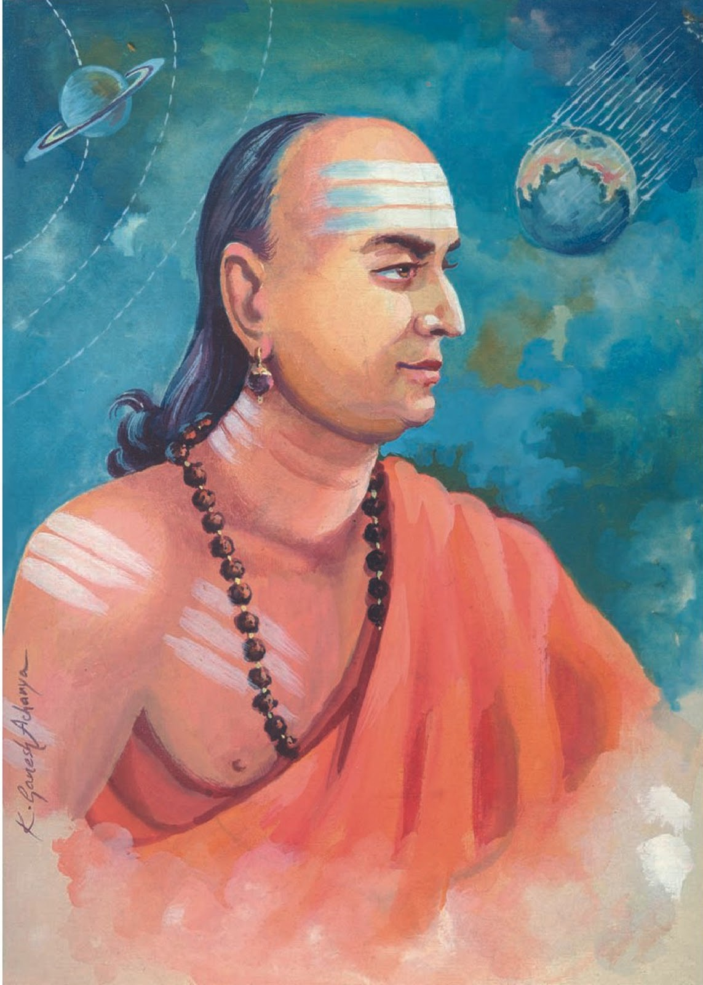
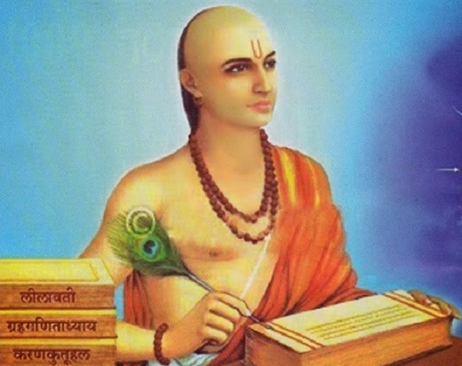
VARAHAMIRA:
THE GREAT INDIAN SCIENTIST AND ASTRONOMER

Slide 2
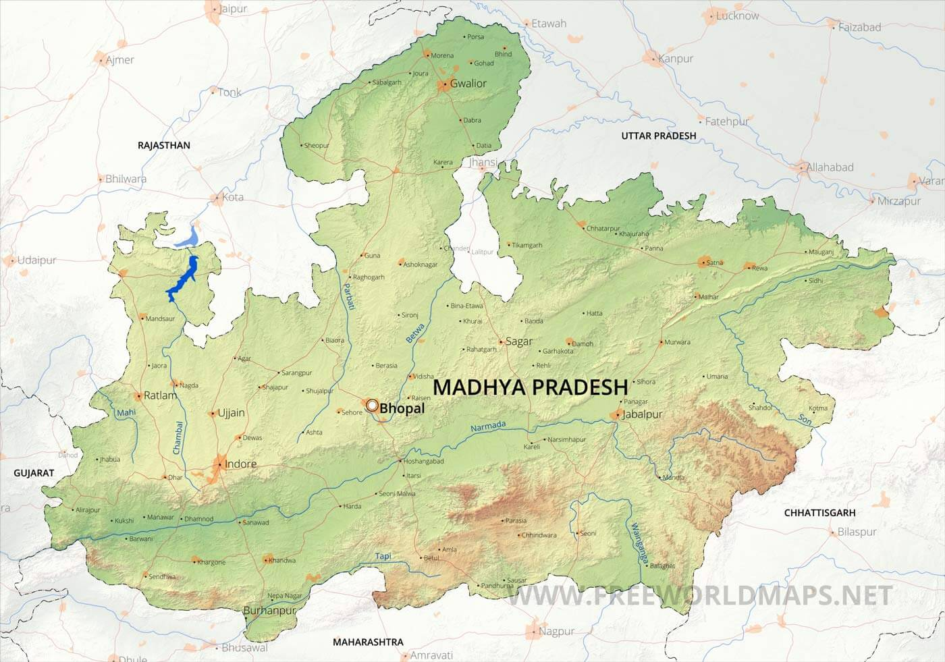
INTRODUCTION
Varāhamihira (505 CE – 587 CE)
Born in Avanti (Ujjain), MP
One of the "Nine Gems" in the court of King Vikramaditya
Major contributions to astronomy, astrology, and meteorology

Slide 3
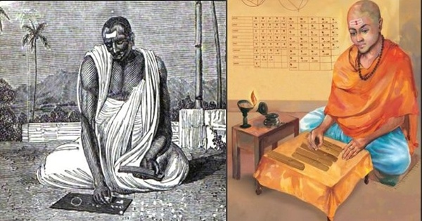
EARLY LIFE
Born to a Brahmin family; father was also an astronomer
Influenced by Greek, Roman, and Indian astronomy
Studied the works of ancient astronomers like Aryabhata

Slide 4
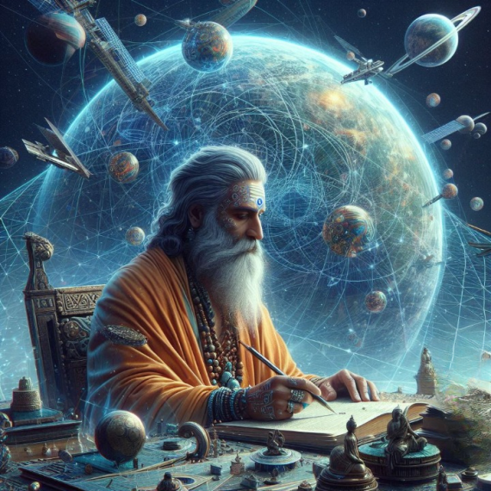
FIELDS OF STUDY
Study in astronomy, astrology,mathematics and meteorology
His role in advancement of scienceduring golden period of learning

Slide 5
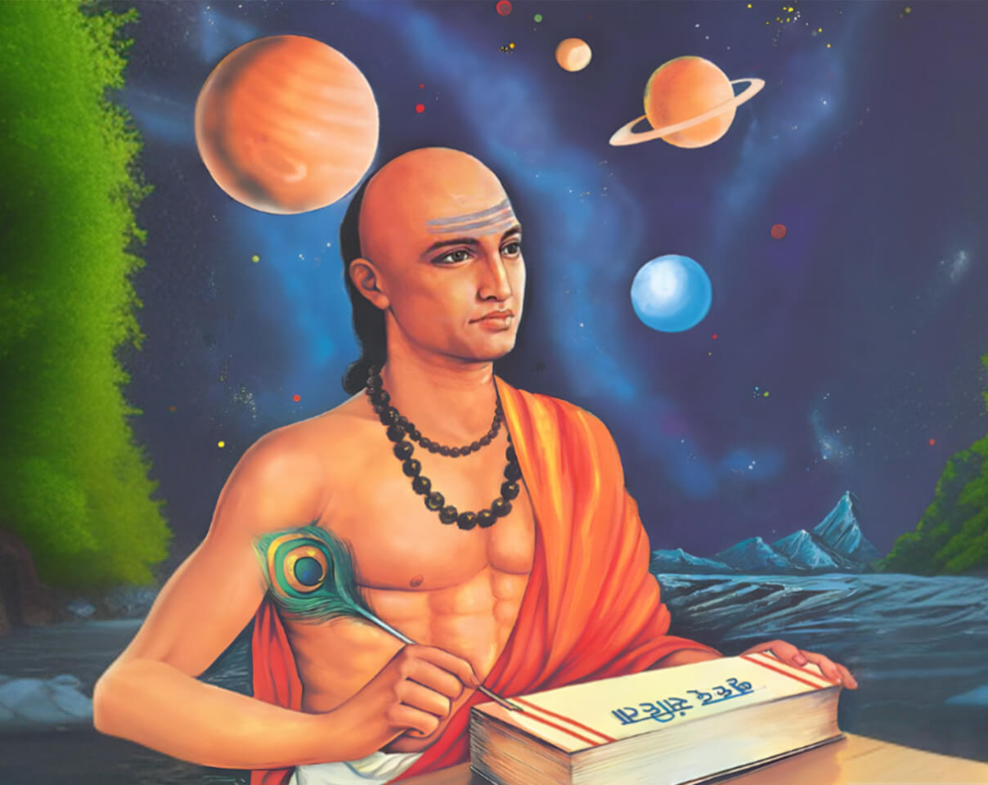
MAJOR WORKS
Varahamihira was an Indian philosopher, astronomer, and mathematician, author of the Pancha-siddhantika, a compendium of Greek, Egyptian, Roman, and Indian astronomy.
Varahamihira's literary works significantly impacted the development of Indian literature, astronomy, and astrology, and they are still studied and appreciated by scholars and practitioners today

Slide 6
MAJOR WORKS
His writings cover various subjects, including astronomy, mathematics, and astrology. Some of his major literary works are:
Brihat Samhita
Brihat Jataka and Laghu Jataka
Pancha-siddhantika,
Surya Siddhanta
Yogayatra

Slide 7
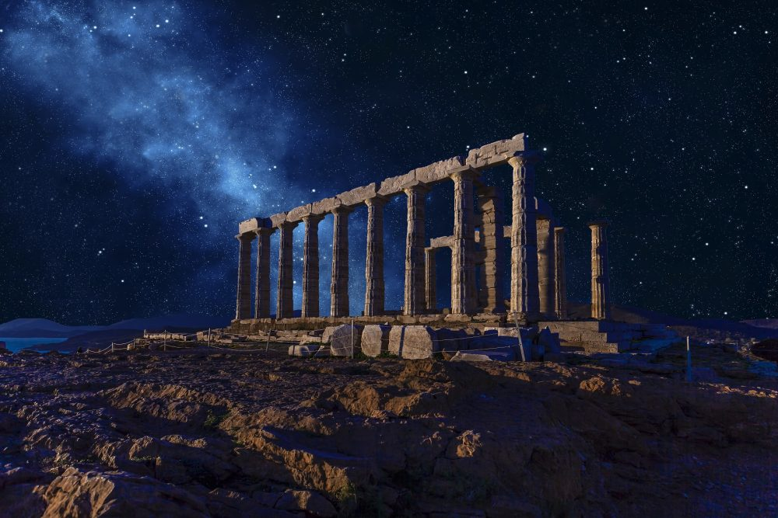
CONTRIBUTIONS TO ASTRONOMY
Varahamihira was the first person to state that the equinox shifts by 50.32 arc seconds per year, or the Ayana.
Varāhamihira was among the earliest to propose that the planets and the Moon do not emit their own light but instead shine due to the reflection of sunlight.
Varāhamihira's most famous astronomical work, the Panchasiddhantika, is a critical synthesis of five earlier astronomical systems (Siddhantas).

Slide 8
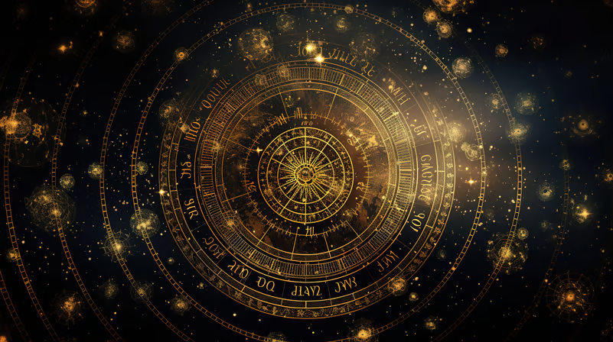
CONTRIBUTIONS TO ASTROLOGY
Varāhamihira's Brihat Samhita's work is a key reference in traditional Indian astrology, contributing to the understanding of planetary influences on human life.
Varāhamihira introduced the use of divisional charts (Vargas) to refine astrological predictions.
Varāhamihira incorporated the concept of karma (the law of cause and effect) into his astrological framework.

Slide 9
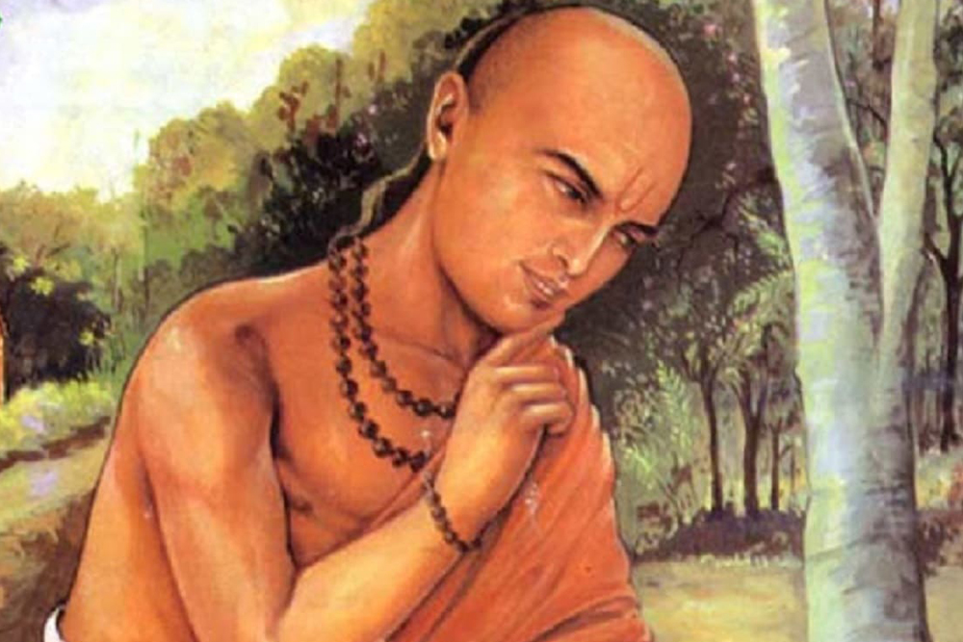
METEROROLOGY AND GEOLOGY
Varahamihira made notable contributions to meteorology in his seminal work, "Brihat Samhita.“
Additionally, he played a pivotal role in the development of the concept of zero, which revolutionized mathematics.
His insights laid the groundwork for future advancements

Slide 10
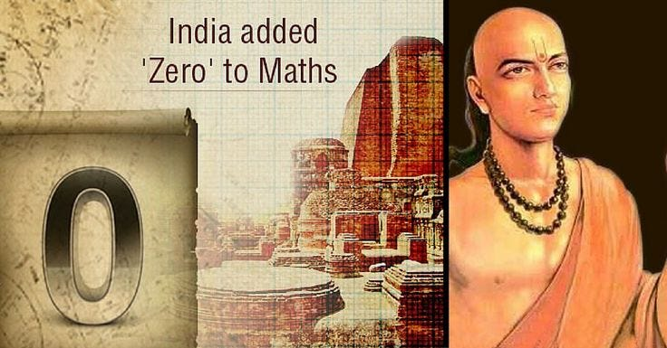
His work on the concept of zero, trigonometry, and sine tables.
Influence on the later mathematicians in India and abroad

Slide 11
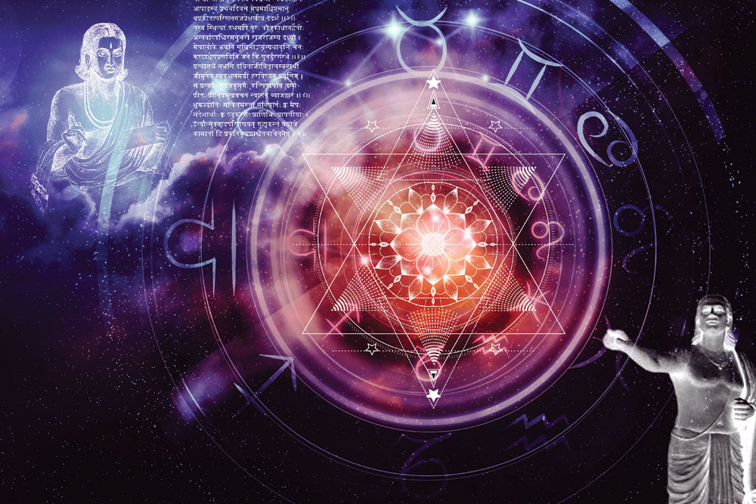
INFLUENCE ON INDIAN SCIENCES
Bridged the gap between Greek and Indian Scientific thought, he wrote the compilation of Greek, Egyptian, roman and Indian astrology called panchsidhanta. Al biruni when came to India translated many of varahamihira books in Arabic.
His work influenced both Indian and Islamic Scholars
His works are still referred in the fields of astronomy and mathematics.

Slide 12
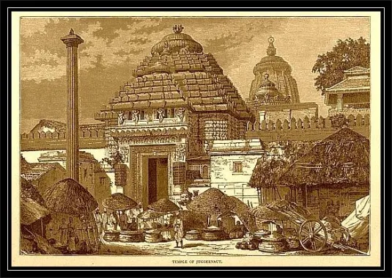
LEGACY
Considered as one of the foremost scientists of ancient India
His works are still referred in fields of astrology and astronomy
Influenced various fields such as architecture, town planning, and environmental studies

Slide 13

THANK YOU
Group Leader – Vraj Ved
Members – Abhishek Upadhyay, Anjali Sinha, Darshan Ved, Naina Singh
Presentation – Darshan Ved, Naina Singh, Vraj Ved
Information and Research – Abhishek Upadhyay, Anjali Sinha
Pictures – Abhishek Upadhyay, Anjali Sinha, Vraj Ved
Animations – Darshan Ved, Vraj Ved
Design – Anjali Sinha, Darshan Ved, Naina Singh
Write Up – Naina Singh
Thank You audience for listening to us
Thanks to all my group members who gave their best in the making of this project

